Slide 1
Test Doubles, Design and Testability
GMU SWE-795, Test Driven Development, Spring 2011, Bill Shelton

Slide 2
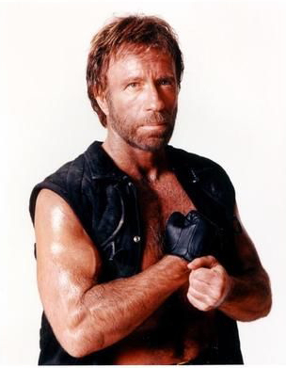
Chuck Norris doesn’t do TDD ...

Slide 3
… because software defects are way too scared to be in his code.

Slide 4
Complete Path Coverage
CPC
Prime Path Coverage
PPC
All-DU-Paths Coverage
ADUP
Edge-Pair Coverage
EPC
All-uses Coverage
AUC
Complete Round Trip Coverage
CRTC
Edge Coverage
EC
All-defs Coverage
ADC
Simple Round Trip Coverage
SRTC
Node Coverage
NC
Introduction to Software Testing (Ch 2)
© Ammann & Offutt

Slide 5
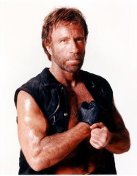
Chuck Norris Coverage
CNC
Complete Path Coverage
CPC
Prime Path Coverage
PPC
All-DU-Paths Coverage
ADUP
Edge-Pair Coverage
EPC
All-uses Coverage
AUC
Complete Round Trip Coverage
CRTC
Edge Coverage
EC
All-defs Coverage
ADC
Simple Round Trip Coverage
SRTC
Node Coverage
NC
Introduction to Software Testing (Ch 2)
© Ammann & Offutt

Slide 6
What are dependencies?
Anything outside of what you’re testing
Obvious examples: (external services) database operations, file I/O, email, calls across a network (logins, FTP, HTTP, etc.)
Less Obvious: Objects that talk to external services.
Third party libraries

Slide 7
Testing with Dependencies: Problems
Slow, Complex Setups and Teardowns, Objects may no exist, not clear what causes a failure
Side effects (Koskella doesn't talk too much about this)
Loose control over what you specifically want to test
You end up routing data through the dependency and you may get unintended results.

Slide 8
Dependencies aren't bad
It can make testing difficult, esp. legacy code
TDD forces you to think harder about object interactions and design
Understanding how to design code to be testable, makes code cleaner

Slide 9
import java.util.List;
public class Emailer {
public boolean sendEmail(List<Recipient> recipients,
String message) {
for(Recipient recipient : recipients){
EmailMessage email = new EmailMessage( recipient, message );
email.send();
}
return true;
}
}

Slide 10
import org.junit.*
public class EmailerTest {
List<Recipient> recipients;
@Before
public void setUp(){
List<Recipient> recipients = new ArrayList();
recipients.add( new Recipient("ed", "ed@ed.com") );
recipients.add( new Recipient("ed2", "ed2@ed.com") );
recipients.add( new Recipient("ed3", "ed3@ed.com") );
recipients.add( new Recipient("ed4", "ed4@ed.com") );
recipients.add( new Recipient("ed5", "ed5@ed.com") );
}
@Test
public void testSendEmail() throws Throwable {
Emailer.sendEmail(recipients, "Thank your visiting teh internets! Please come again.");
}
}

Slide 11
A Few Unit Testing Principals
Controllability
Isolation
Speed
Accuracy
Coverage

Slide 12
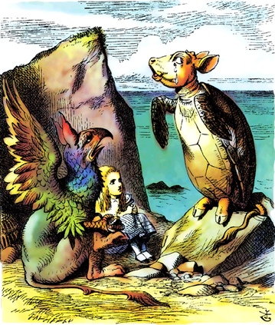
“Once,”
the Mock Turtle said at last, with a deep sigh,
“I was a real turtle”
Lewis Carroll, Alice's Adventures in Wonderland

Slide 13
Types of Mocks
Gerard Meszaros classifies these as Test Doubles
Stubs, Fakes, Mocks,Test Spies
Martin Fowler makes a distinction between mocks and stubs

Slide 14
Behavior vs. State
State returns some data type (Ask) and unit tests verify the contract by inspecting expected state of the object under test
Behavior does some action (Tell) and usually returns void. Unit tests verify method calls on collaborating objects. (Also referred to as Interaction Testing)

Slide 15

Gold
Mocks address the problem of handling dependencies, but the a TDD approach using mocks can help discovering needed types and interfaces.
Need Driven Development

Slide 16
Other Applications?
Discovery of Types and Interfaces [REF]
Simulation Scenarios:
Software Fault Injection
Mimic specific mutation operators without generating mutant artifacts?

